Slide 1
Big Data
Database Systems

Slide 2
Information Storage
Data
Data is a collection of raw facts from which conclusions might be drawn.
Examples include
Handwritten letters, a printed book, a family photograph, a bank’s ledgers, and an airline ticket are all examples that contain data.

Slide 3
Information Storage
Digital data
Before the advent of computers, the methods adopted for data creation and sharing were limited.
Today, the same data can be converted into more convenient forms, such as an e-mail message, an e-book, a digital image, or a digital movie. This data can be generated using a computer and stored as strings of binary numbers (0s and 1s).
Data in this form is called digital data and is accessible by the user only after a computer processes it.

Slide 4
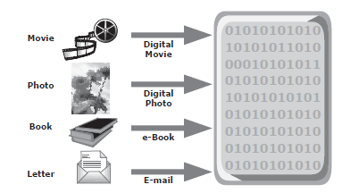
Digital data

Slide 5
Big data
'Big Data' is also a data but with a huge size.
'Big Data' is a term used to describe collection of data that is huge in size and yet growing exponentially with time.
In short, such a data is so large and complex that none of the traditional data management tools are able to store it or process it efficiently.

Slide 6
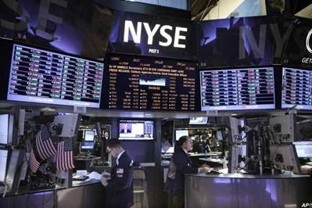
Examples Of 'Big Data'
The New York Stock Exchange generates about one terabyte of new trade data per day.

Slide 7

Social Media Impact
Statistic shows that 500+terabytes of new data gets ingested into the databases of social media site Facebook, every day.
This data is mainly generated in terms of photo and video uploads, message exchanges, putting comments etc.

Slide 8

Single Jet engine can generate 10+terabytes of data in 30 minutes of a flight time. With many thousand flights per day, generation of data reaches up to many Petabytes.

Slide 9
Categories Of 'Big Data'
Big data could be found in three forms:
Structured
Unstructured
Semi-structured

Slide 10
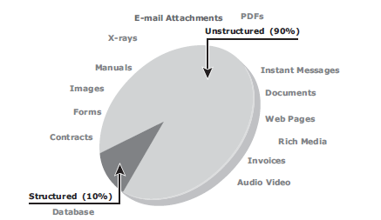

Slide 11
Structured
Any data that can be stored, accessed and processed in the form of fixed format is termed as a 'structured' data.
Employee_ID | Employee_Name | Gender | Department | Salary_In_lacs
2365 | Rajesh Kulkarni | Male | Finance | 650000
3398 | Pratibha Joshi | Female | Admin | 650000
7465 | Shushil Roy | Male | Admin | 500000
7500 | Shubhojit Das | Male | Finance | 500000
7699 | Priya Sane | Female | Finance | 550000

Slide 12
Unstructured
Any data with unknown form or the structure is classified as unstructured data.
In addition to the size being huge, un-structured data poses multiple challenges in terms of its processing for deriving value out of it.
Typical example of unstructured data is, a heterogeneous data source containing a combination of simple text files, images, videos etc.
Now a day organizations have wealth of data available with them but unfortunately they don't know how to derive value out of it since this data is in its raw form or unstructured format.

Slide 13
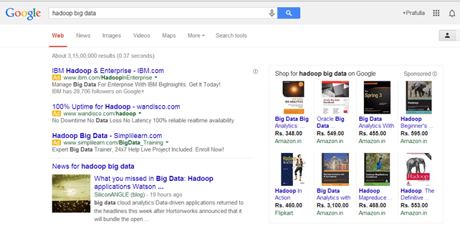
Examples Of Un-structured Data
Output returned by 'Google Search‘

Slide 14
Semi-structured
Semi-structured data can contain both the forms of data.
We can see semi-structured data as a structured in form but it is actually not defined with e.g. a table definition in relational DBMS.
Semi-structured data is information that doesn’t reside in a relational database but that does have some organizational properties that make it easier to analyze.
Example of semi-structured data is a data represented in XML file.

Slide 15
Need for Big Data
Nowadays data come in different forms.
Many of the analytical solutions were not possible in the past due to the cost of implementation and lack of professionals.
With this, we are capable of performing complex algorithms on machine data within a time interval.
These have many real-time use cases such as fraud-detection, targeting audience on a global platform, web advertising, etc.

Slide 16
Characteristics Of 'Big Data'
Also called 3Vs of Big Data
Volume
Variety
Velocity
Now a days, 2 more Vs are added to the characteristics of Big data i.e. Veracity and Value.

Slide 17
1. Volume
The name 'Big Data' itself is related to a size which is enormous.
Size of data plays very crucial role in determining value out of data.
Also, whether a particular data can actually be considered as a Big Data or not, is dependent upon volume of data.
Hence, 'Volume' is one characteristic which needs to be considered while dealing with 'Big Data'.

Slide 18
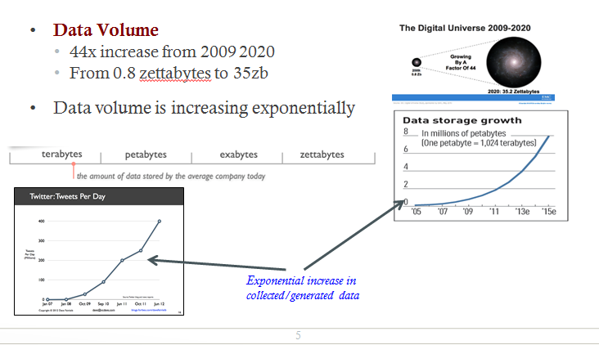

Slide 19
2. Variety
The next aspect of 'Big Data' is its variety.
Variety refers to heterogeneous sources and the nature of data, both structured and unstructured.
During earlier days, spreadsheets and databases were the only sources of data considered by most of the applications.
Now days, data in the form of emails, photos, videos, monitoring devices, PDFs, audio, etc. is also being considered in the analysis applications.
This variety of unstructured data poses certain issues for storage, mining and analyzing data.

Slide 20
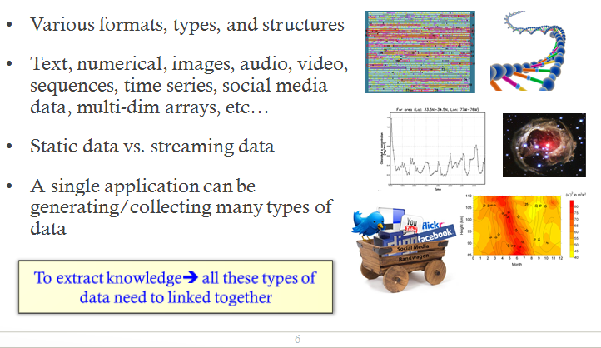

Slide 21
3. Velocity
The term 'velocity' refers to the speed of generation of data.
How fast the data is generated and processed to meet the demands, determines real potential in the data.
Big Data Velocity deals with the speed at which data flows in from sources like business processes, application logs, networks and social media sites, sensors, Mobile devices, etc.
The flow of data is massive and continuous.

Slide 22
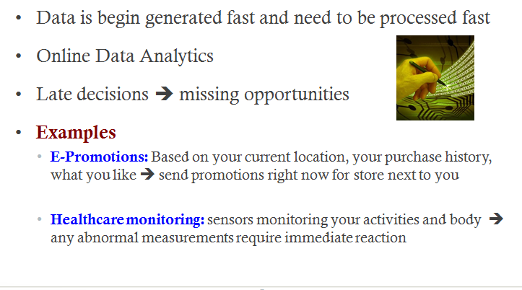

Slide 23
Benefits of Big Data Processing
Smarter Healthcare
Traffic Control
Manufacturing
Multi-channel sales
Telecom
Trading Analytics
Search Quality

Slide 24
Big data ecosystem
The big data ecosystem consists of the following:
Devices that collect data from multiple locations and also generate new data about this data (metadata).
Data collectors who gather data from devices and users.
Data aggregators that compile the collected data to extract meaningful information.
Data users and buyers who benefit from the information collected and aggregated by others in the data value chain.

Slide 25
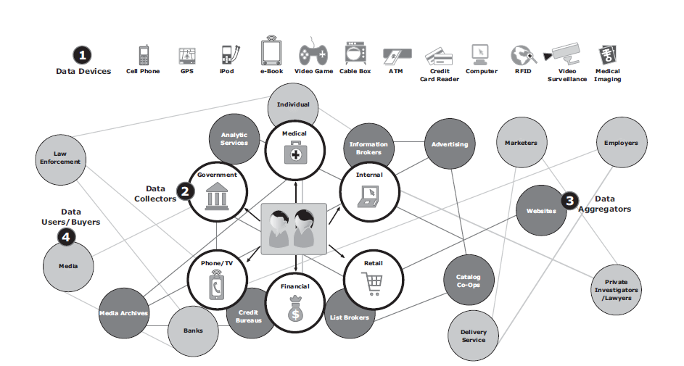
Big data ecosystem

Slide 26
NoSQL
NoSQL is an approach to database design that can accomodate a wide variety of data models, including key-value, document, columnar and graph formats.
NoSQL, which stand for "not only SQL," is an alternative to traditional relational databases in which data is placed in tables and data schema is carefully designed before the database is built.
NoSQL databases are especially useful for working with large sets of distributed data.

Slide 27
Major issues of Relational Databases
Relational databases were designed for tabular data, with a consistent structure and a fixed schema. They work best for problems that are well defined at the outset. But not good to manage unstructured data.
A Large Number of JOINs
When you utilize queries that join many different tables, there’s an explosion of complexity and computing resource consumption. This results in a corresponding increase in query response times.
Frequent Schema Changes
Slow-Running Queries (Despite Extensive Tuning)

Slide 28
Why NoSQL
Document Oriented Storage: Data is stored in the form of JSON style documents.
Replication and high availability
Fast in-place updates

Slide 29
Characterisics of NoSQL
It’s more than rows in tables—NoSQL systems store and retrieve data from many formats: key-value stores, graph databases, column-family (Bigtable) stores, document stores, and even rows in tables.
It’s free of joins—NoSQL systems allow you to extract your data using simple interfaces without joins.
It’s schema-free—NoSQL systems allow you to drag-and-drop your data into a folder and then query it without creating an entity-relational model.
It works on many processors—NoSQL systems allow you to store your database on multiple processors and maintain high-speed performance.
It uses shared-nothing commodity computers—Most (but not all) NoSQL systems leverage low-cost commodity processors that have separate RAM and disk.
It supports linear scalability—When you add more processors, you get a consistent increase in performance.

Slide 30
Data Models of NoSQL
Key-value datamodel
Document data model
Column Family data model
Graph data model

Slide 31
Key value data model
These databases store data as key-value pairs, and are optimized for simple and fast read/write operations.

Slide 32
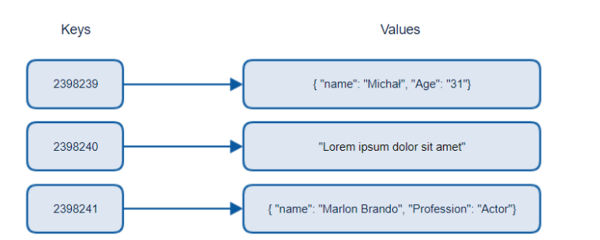
Key value data model

Slide 33
Document Data model
These databases store data as semi-structured documents, such as JSON or XML, and can be queried using document-oriented query languages.
JavaScript Object Notation (JSON) is a standard text-based format for representing structured data based on JavaScript object syntax.

Slide 34
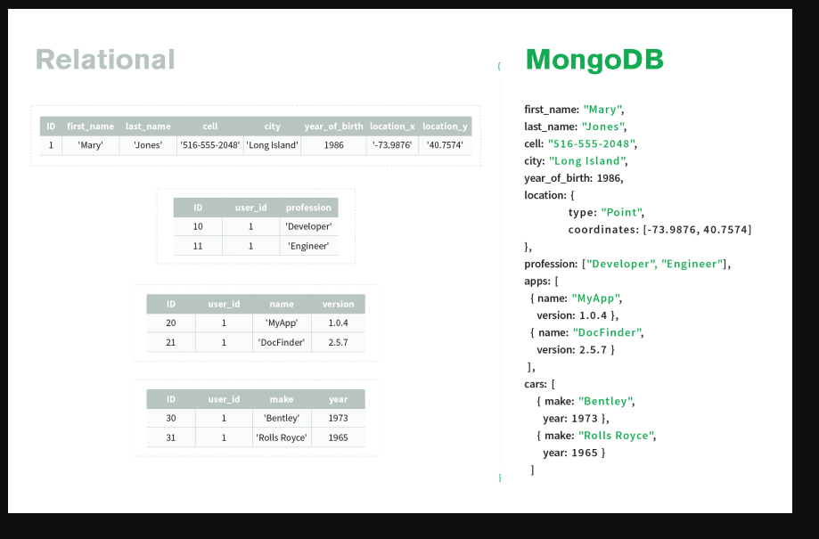
Document Data model

Slide 35
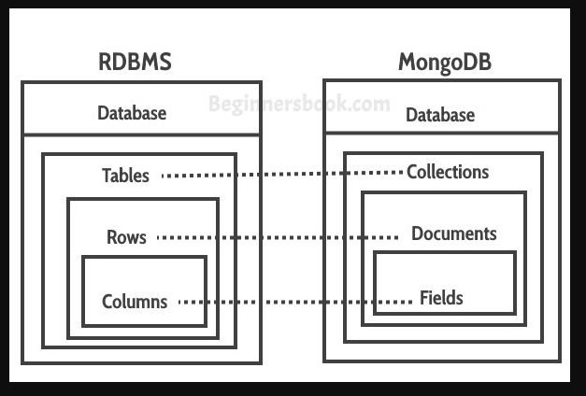
Document data model

Slide 36
Column Family data model
These databases store data as column families, which are sets of columns that are treated as a single entity.
They are optimized for fast and efficient querying of large amounts of data.

Slide 37
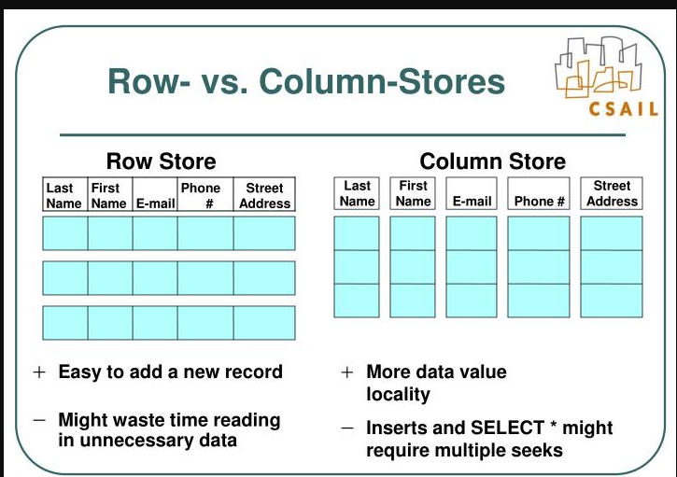
Column family data model

Slide 38
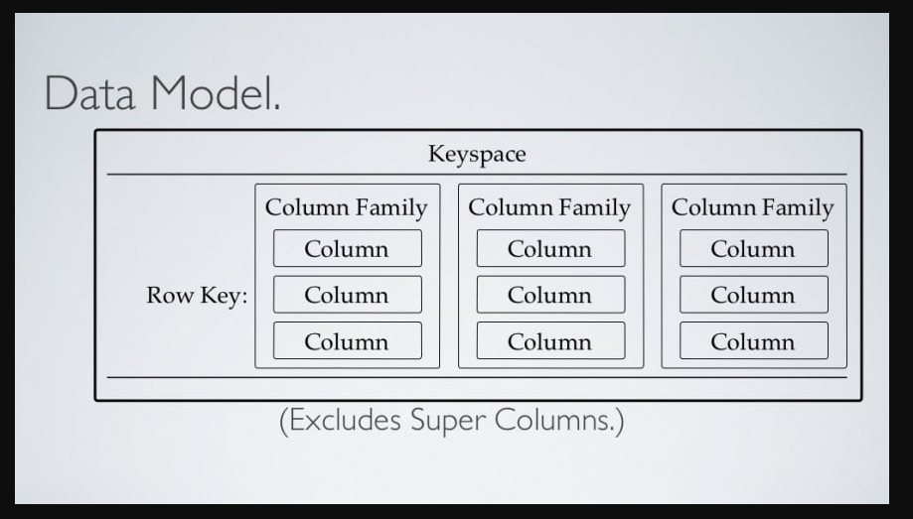
Column family data model

Slide 39
Graph data model
These databases store data as nodes and edges, and are designed to handle complex relationships between data.

Slide 40
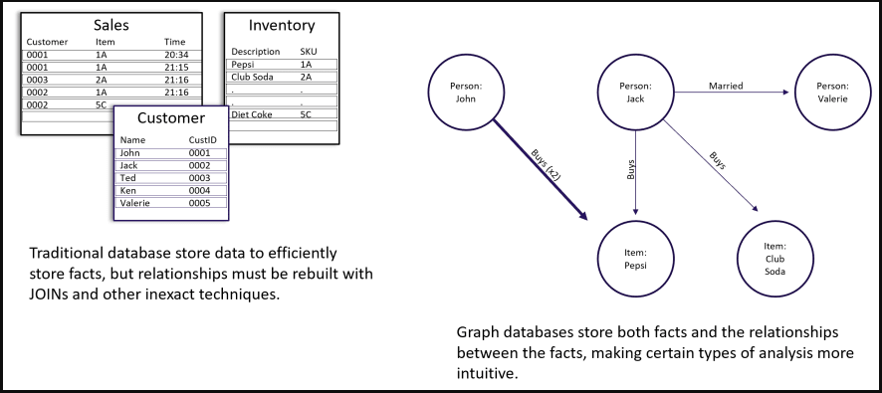
Graph data model

Slide 41
Thank You

